Slide 1
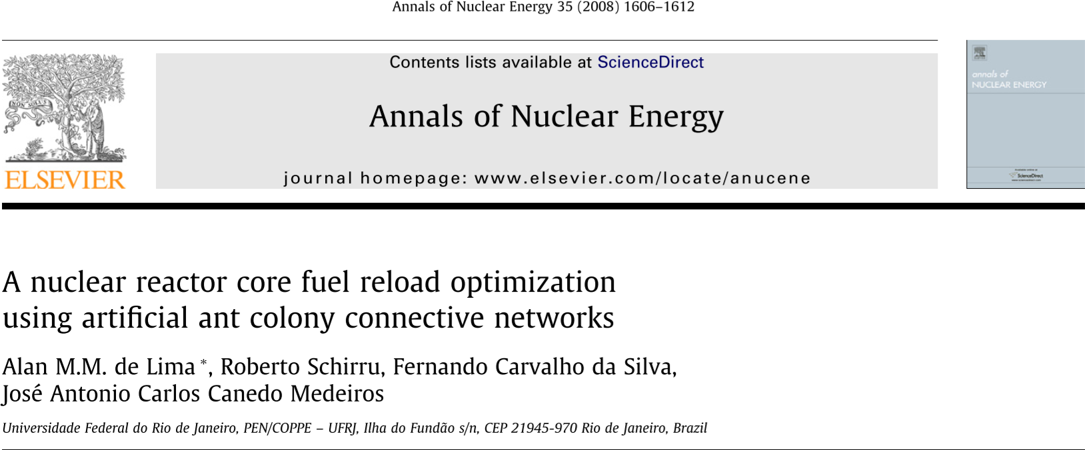

Slide 2
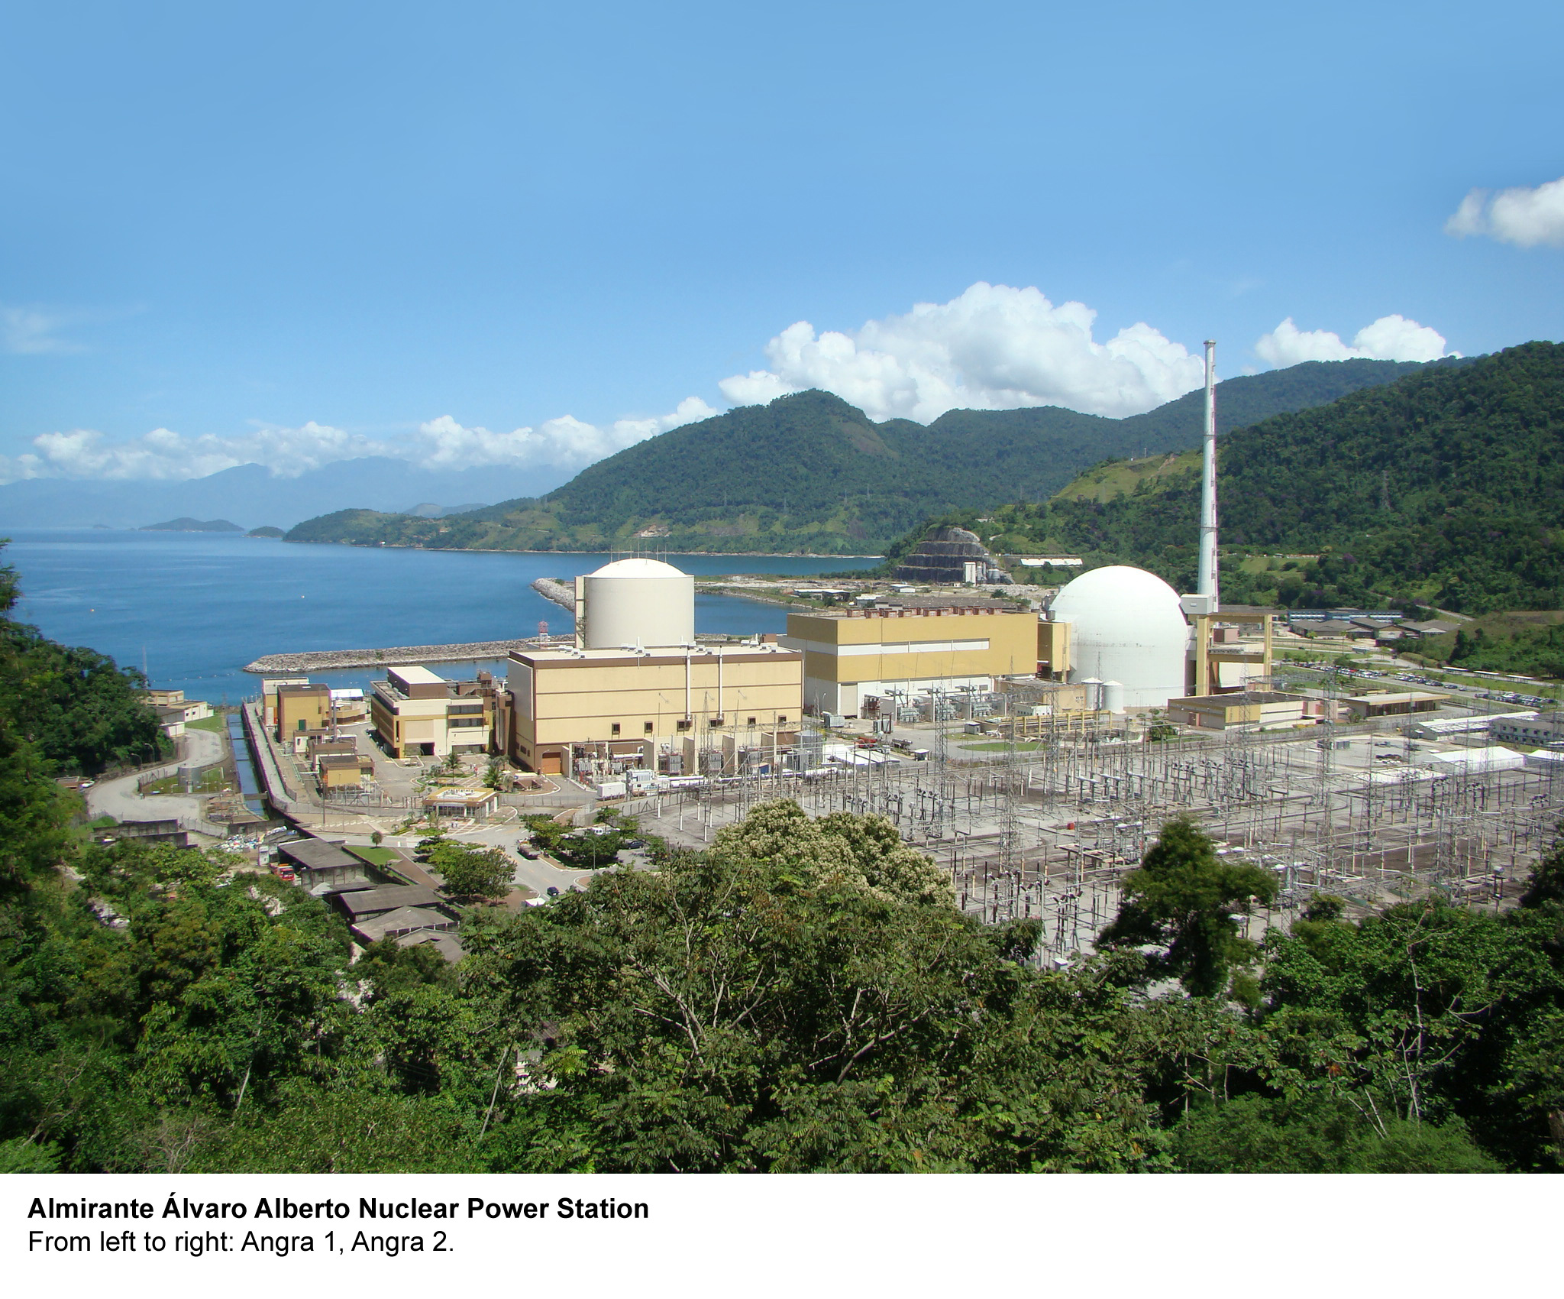
Angra 1 and 2 Rio de Janeiro, Brazil
Angra 1 and 2 Rio de Janeiro, Brazil

Slide 3
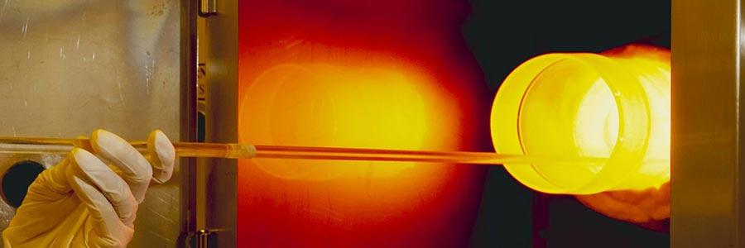


Load Pattern Optimization Techniques
Simulated Annealing
Genetic Algorithm
Ant Colony Simulation

Slide 4

Simulated Annealing
Where it’s used:
FORMOSA (Fuel Optimization for Reloads: Multiple Objectives by Simulated Annealing) Code¹
Westinghouse’s ShuffleWorks® software² to reduce refueling time
How it works: Acceptance probability function describes the probability of making the transition from the current state to another state
Probability of achieving optimal result increases with annealing time
Ex: Pixels rearranged to minimize potential energy
Kropackzek and Turinsky, “In-core nuclear fuel management optimization for pressurized water reactors utilizing simulated annealing,” Nucl. Tech., 95 (9) 1991.
Westinghouse, “ShuffleWorks® System: Enhanced EPRI Core Shuffler,” (http://www.westinghousenuclear.com/Portals/0/operating%20plant%20services/fuel/fuel%20engineering%20services/NS-ES-0009%20ShuffleWorks.pdf).
Notes:
Fun fact: Westinghouse promotes using computers because of space efficiency in control room

Slide 5

Simulated Annealing
...
Notes:
The algorithm finds a solution → picks the next solution biased towards better solution (but not exclusively, otherwise it would always converge to a local max, but not a global max; notice that the global max is hit several times in the gif, but then it’s abandoned)
As temperature drops, the algorithm becomes less willing to “explore”; ideally it will still be considering the global max among its solutions, but it will now be less willing to leave that global max

Slide 6
Genetic Algorithm
Where it’s used: CIGARO (Code Independent Genetic Algorithm Reactor System) code¹
How it works:²
Classical Algorithm | Genetic Algorithm
Single point at each iteration Sequence of points → optimal Deterministic calculation to select next point | Population of points at each iteration Best point → optimal Random number generator to select next population
M.D. Dechaine and M.A. Feltus, “Nuclear Fuel Management optimization using generic algorithms,” Nucl. Tech., 3 (1995).
MathWorks, “Genetic algorithms,” https://www.mathworks.com/discovery/genetic-algorithm.html).

Slide 7


Slide 8
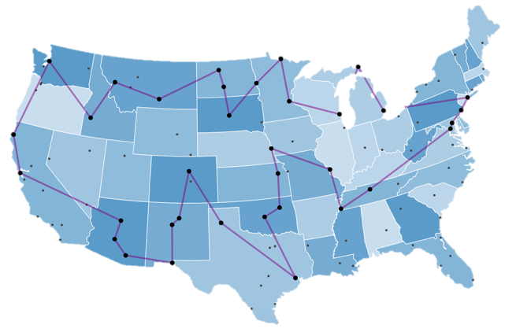
Traveling Salesman Problem (TSP)
Given a set of cities...
Starting from an initial city
Visit all cities in shortest possible distance
Return to original city
Solutions:
Test every possible tour through the cities
Problem is NP-Hard
For N cities, there are N! combinations
Notes:
NP-hard = non-deterministic, polynomial-time hardness, meaning at least as hard as the hardest

Slide 9
Traveling “Ant” Problem
Instead, solve using biomimicry
Ant colony system
Artificial bee colony
Not necessary to cover the entire parameter space
Ants find food & return to nest without exploring (or even seeing) their entire environment
Eventually find the shortest route without a sense of direction, sight, or memory
First published by Marco Dorigo, Vittorio Maniezzo and Alberto Coloni in 1996.
Dorigo, M., Maniezzo, V., Coloni, A. “Ant System: Optimization by a Colony of Cooperating Agents.” IEEE Transactions on Systems, Man, and Cybernetics–Part B. 1996.
Notes:
NP-hard = non-deterministic, polynomial-time hardness, meaning at least as hard as the hardest

Slide 10

Ant Colony Optimizations
Positive Feedback Loop
Choose paths high in pheromone
Deposit Pheromone

Slide 11

Ant Colony Optimizations
t = 0 min
Notes:
Say an ant walks at rate 1 unit per minute on a line of length 10. Another ant walks at the same rate on a line of length 5. In 10 minutes, a single layer of pheromone is deposited on the length 10 line, while a double layer of pheromone is deposited on the length 5 line (once out and back).

Slide 12
Ant Colony Optimizations
t = 5 min
Notes:
Say an ant walks at rate 1 unit per minute on a line of length 10. Another ant walks at the same rate on a line of length 5. In 10 minutes, a single layer of pheromone is deposited on the length 10 line, while a double layer of pheromone is deposited on the length 5 line (once out and back).

Slide 13
Ant Colony Optimizations
t = 10 min
Notes:
Say an ant walks at rate 1 unit per minute on a line of length 10. Another ant walks at the same rate on a line of length 5. In 10 minutes, a single layer of pheromone is deposited on the length 10 line, while a double layer of pheromone is deposited on the length 5 line (once out and back).

Slide 14

Ant Colony Optimizations
In theory, this positive feedback loop should converge on the correct solution quickly.
All ants will pick the shorter path.
There are some interesting results when this process is explored in detail, however.
github.com/mnegus01/ant-optimization
Notes:
Say an ant walks at rate 1 unit per minute on a line of length 10. Another ant walks at the same rate on a line of length 5. In 10 minutes, a single layer of pheromone is deposited on the length 10 line, while a double layer of pheromone is deposited on the length 5 line (once out and back).

Slide 15
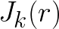
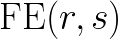
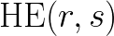
Some definitions...
The ant’s current city.
The next city in the tour.
The list of cities still left for the ant to explore
The pheromone currently on segment (r,s)
The visibility of segment (r,s)
Notes:
We are relaxing our constraint that the ants can’t see by including HE(r,s)

Slide 16
The Ant System
(AS)

Slide 17
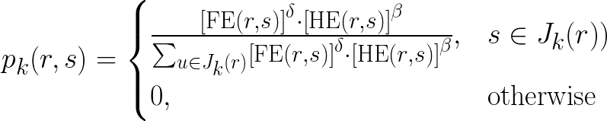
The Ant System (AS)
For each ant, k
Probabilistically choose the next city. Pick the path maximizing the combo of
Visibility (don’t go far away)
Pheromone (go where ants have gone before)
Dorigo, M., Maniezzo, V., Coloni, A. “Ant System: Optimization by a Colony of Cooperating Agents.” IEEE Transactions on Systems, Man, and Cybernetics–Part B. 1996.

Slide 18
The Ant System (AS)
For each ant, k
Probabilistically choose the next city. Pick the path maximizing the combo of
Visibility (don’t go far away)
Pheromone (go where ants have gone before)
Evaluate combination
for every unvisited city
Dorigo, M., Maniezzo, V., Coloni, A. “Ant System: Optimization by a Colony of Cooperating Agents.” IEEE Transactions on Systems, Man, and Cybernetics–Part B. 1996.

Slide 19
The Ant System (AS)
For each ant, k
Probabilistically choose the next city. Pick the path maximizing the combo of
Visibility (don’t go far away)
Pheromone (go where ants have gone before)
… and normalize
Dorigo, M., Maniezzo, V., Coloni, A. “Ant System: Optimization by a Colony of Cooperating Agents.” IEEE Transactions on Systems, Man, and Cybernetics–Part B. 1996.

Slide 20
The Ant System (AS)
For each ant, k
Probabilistically choose the next city. Pick the path maximizing the combo of
Visibility (don’t go far away)
Pheromone (go where ants have gone before)
The city’s already been visited.
Dorigo, M., Maniezzo, V., Coloni, A. “Ant System: Optimization by a Colony of Cooperating Agents.” IEEE Transactions on Systems, Man, and Cybernetics–Part B. 1996.
Notes:
Beta and gamma are weighting parameters for the visibility and the pheromone

Slide 21
The Ant System (AS)
After completing the tour
Update the pheromone at each point of the path.
Consider pheromone evaporation
Deposit pheromone on path r → s from each ant on that route
Dorigo, M., Maniezzo, V., Coloni, A. “Ant System: Optimization by a Colony of Cooperating Agents.” IEEE Transactions on Systems, Man, and Cybernetics–Part B. 1996.
Notes:
q_0 is a random variable in uniform distribution [0,1]
First case is exploitation:
some fraction of the time, don’t bother considering the probability distribution, just pick the best edge
Second case is biased exploration:
Consider the probability distribution (biased due to probabilities, but still allows exploration even if prob is low)

Slide 22
The Ant Colony System
(ACS)

Slide 23
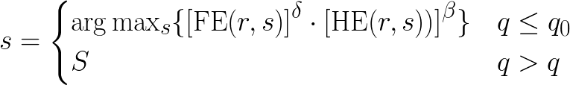
The Ant Colony System (ACS)
For each ant, k
Use a state transition rule, in addition to a probabilistic distribution, to determine the next city.
S is the same probability distribution as before.
Dorigo, M., Maniezzo, V., Coloni, A. “Ant System: Optimization by a Colony of Cooperating Agents.” IEEE Transactions on Systems, Man, and Cybernetics–Part B. 1996.
Notes:
q_0 is a random variable in uniform distribution [0,1]
First case is exploitation:
some fraction of the time, don’t bother considering the probability distribution, just pick the best edge
Second case is biased exploration:
Consider the probability distribution (biased due to probabilities, but still allows exploration even if prob is low)

Slide 24
The Ant System (ACS)
After completing a transition (between cities)
Apply a local pheromone update to each traversed path. LOCAL
After completing the tour
Update the pheromone at each point of the only the best path. GLOBAL
For both pheromone updates:
Consider pheromone evaporation
Deposit pheromone on path r → s
Dorigo, M., Maniezzo, V., Coloni, A. “Ant System: Optimization by a Colony of Cooperating Agents.” IEEE Transactions on Systems, Man, and Cybernetics–Part B. 1996.
Notes:
q_0 is a random variable in uniform distribution [0,1]
First case is exploitation:
some fraction of the time, don’t bother considering the probability distribution, just pick the best edge
Second case is biased exploration:
Consider the probability distribution (biased due to probabilities, but still allows exploration even if prob is low)

Slide 25
Artificial Ant Colony Networks
(AACN)

Slide 26
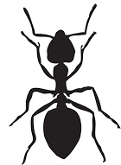

Artificial Ant Colony Networks
Ant “colonies” search independently for solutions, and are implemented in parallel.
Progress is shared among the colonies.
Notes:
q_0 is a random variable in uniform distribution [0,1]
First case is exploitation:
some fraction of the time, don’t bother considering the probability distribution, just pick the best edge
Second case is biased exploration:
Consider the probability distribution (biased due to probabilities, but still allows exploration even if prob is low)

Slide 27
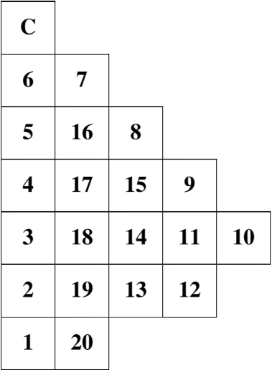
From Ants to Fuel Assemblies...
Order matters! Ex.) Moving between high and low-flux rods
Local heuristic depends on burnup calculation → nonlinear problem
FAs can move; cities can’t
A. Menesses, “Artificial Intelligence Methods Applied to the In-Core Nuclear Fuel Management Optimization,”
Notes:
TSP objective function: total sum of distances between cities in the order they are visited
Moving between two cities is independent of when in the journey the move is made
Local heuristic
Know about the global system by knowing only about FAs directly neighboring the current FA

Slide 28
Heuristics
“Any approach to problem solving or learning that employs a practical method not guaranteed to be optimal, but sufficient for immediate goals.”

Slide 29
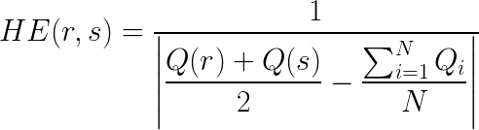
Leveling Heuristic
Position FAs to maintain local average burnup closest to global value
Q(i) = burnup of i^{th} FA
N = total number of FAs
Average burnup between current and next FA
Average burnup for core

Slide 30
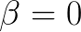
2. Global Heuristic
No local heuristic. The ants have no “visibility” and the outcome of the optimization is based entirely on the ant’s decisions based on pheromone levels.

Slide 31
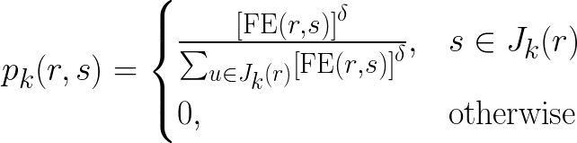
2. Global Heuristic
No local heuristic. The ants have no “visibility” and the outcome of the optimization is based entirely on the ant’s decisions based on pheromone levels.

Slide 32
3. Parasite Heuristic
Again, and ants rely only on pheromone levels when making decisions…
...but only for the first 50 generations (tours).
t = 0
t = 50
t = 100
FE₀(r,s) = 0
FE₅₀(r,s) = 0
FE₁₀₀(r,s) = 0
HE₅₀(r,s) = F₅₀(r,s)
HE₁₀₀(r,s) = F₁₀₀(r,s)
Solution//////
Notes:
Only parasitic if you consider humans learning things out of textbooks parasitic, because they didn’t discover things for themselves but instead rely on other people who did it first.

Slide 33
Results
Complete case: 200 ants
Simplified case: 20 ants

Slide 34
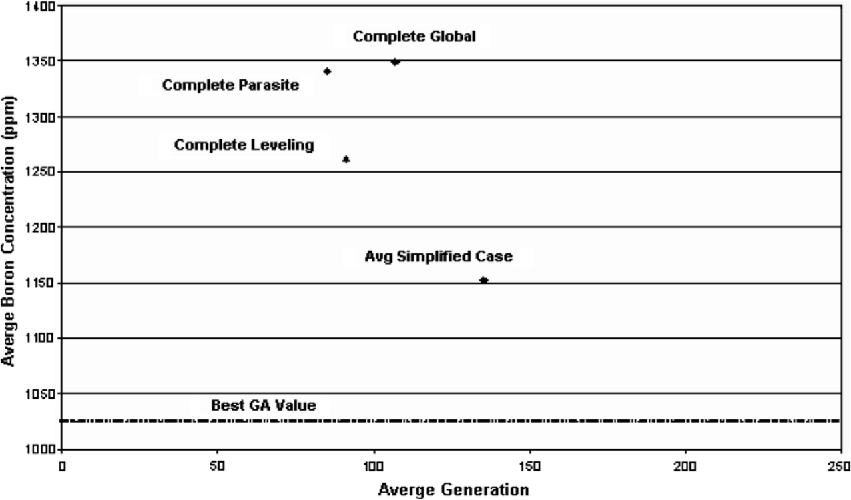
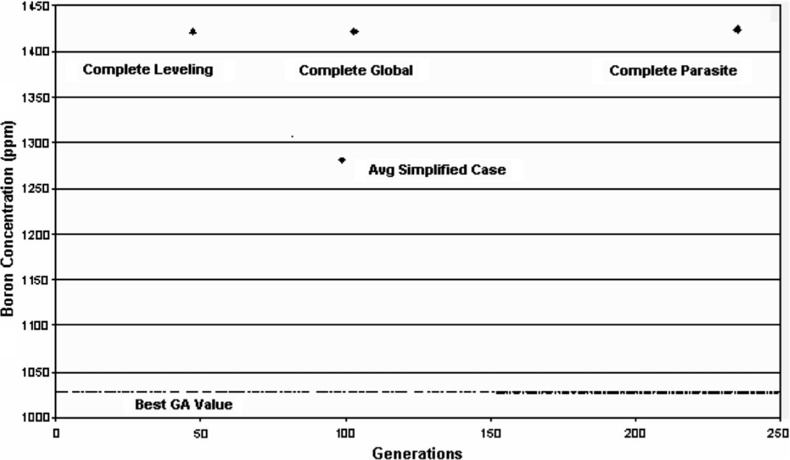
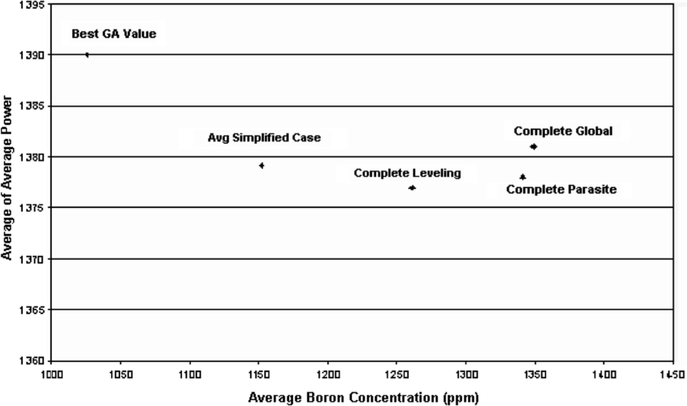
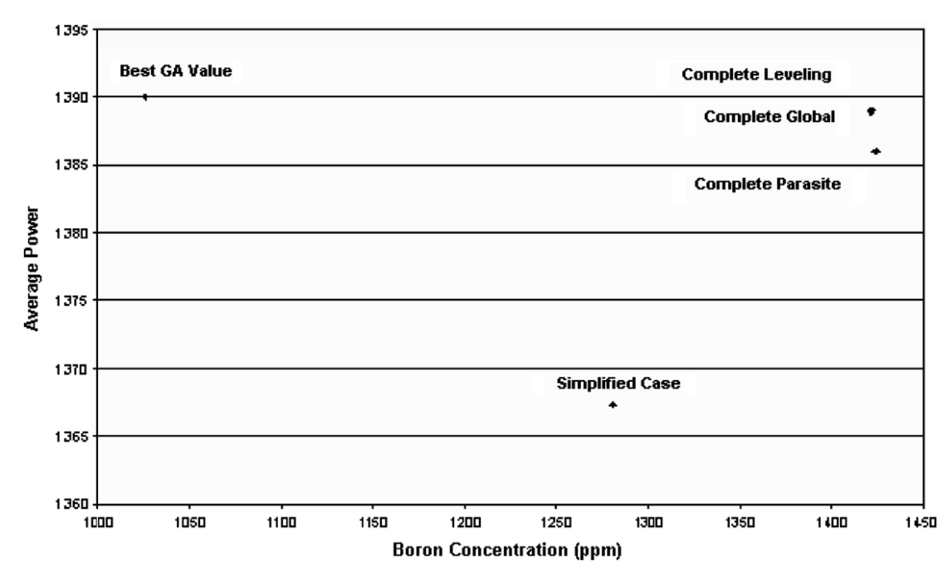

Slide 35
Average values for all trials of each heuristic

Slide 36
Best values of each heuristic

Slide 37
Boron concentration
vs. generation

Slide 38
Boron concentration
vs. generation
Result nearest the top left corner is best

Slide 39
Average power vs. boron concentration

Slide 40
Average power vs. boron concentration
Result nearest the bottom right corner is best

Slide 41
Complete global method is best?

Slide 42

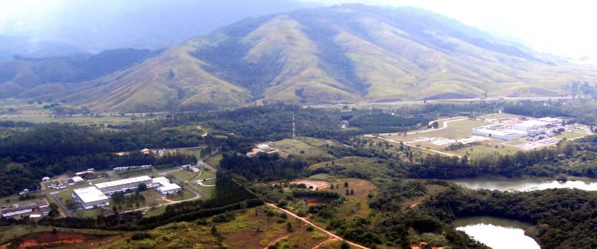
Resende Nuclear Fuel Factory¹
2002 Enrichment facility “opened”
2004 IAEA proposes change in fuel rods used in Angra 1+2 (UO2 → UO2-Gd2U3)²
2009 Operating license granted
2016 UO2 export to Argentina began
Resende enrichment and nuclear fuel plant, Rio de Janeiro,” (http://www.wise-uranium.org/eproj.html#RESENDEENR).
A. Abe, “Critical loading configurations of the IPEN/MB-01 reactor with UO2-Gd2O3 burnable poison rods,” INAC 2009.
Resende enrichment and nuclear fuel plant, Rio de Janeiro,” (http://www.wise-uranium.org/eproj.html#RESENDEENR).
A. Abe, “Critical loading configurations of the IPEN/MB-01 reactor with UO2-Gd2O3 burnable poison rods,” INAC 2009.

Slide 43
Most recent work
Anderson Alvarenga de Moura Meneses, et al., “Application of metaheuristics to Loading Pattern Optimization problems based on the IAEA-3D and BIBLIS-2D data,” Annals of Nuclear Energy, 111 (Jan 2018).
Loading Pattern Optimization (LPO)
Cycle length
Keff
Power peaking factor
“Bee colony network”

Slide 44
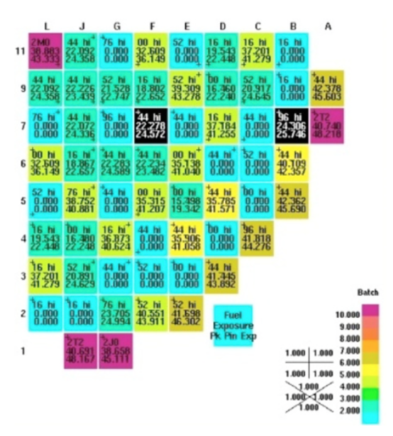
Other interest
Currently used:
Westinghouse ShuffleWorks® code (simulated annealing)
Studsvik XIMAGE/SIMAN-PWR software with graphical user interface (simulated annealing)
Research area of interest:
Tractebel (Belgian company) developing load pattern optimization technology (simulated annealing and genetic algorithms)
Research looking at genetic algorithms for VVER

Slide 45
Comments/questions?
Comments/questions?

